Slide 1


Ad-Hoc Insights
Consumer goods
Presented by :Aayushi Saxena

Slide 2

Content
1. Company Overview 2. Problem statement 3. Dataset and model 4. Ad-hoc requests , output and insights 5. Recommendations

Slide 3


Company Overview
AtliQ Hardware is a leading provider of high-quality computer peripherals, including PCs, mouse, keyboards etc. catering to customers in India and across the globe.

Slide 4
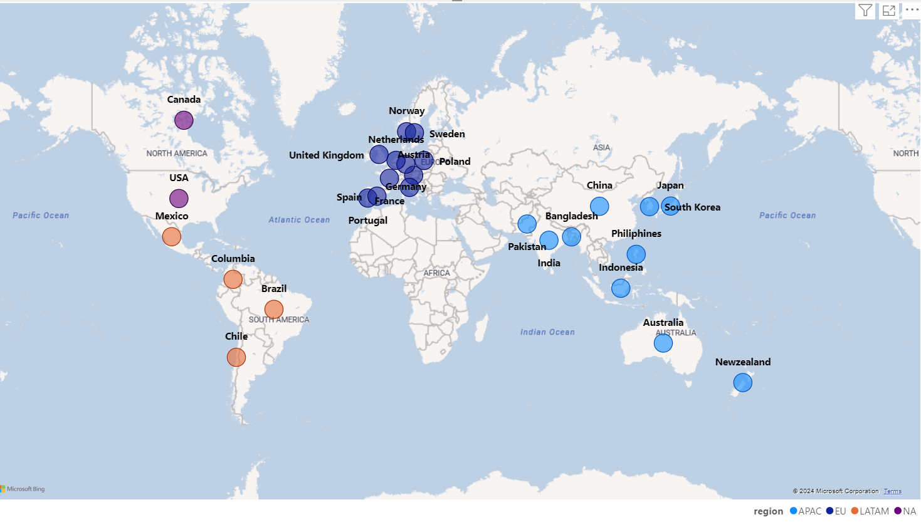
Markets

Slide 5
Products
Desktop
0
Peripherals
0
1
Internal HDD
Graphic Card
Processors
MotherBoard
6
Business Laptop
Personal Desktop
PC
P & A
Products
Notebook
0
Accessories
5
2
0
Mouse
Keyboard
Batteries
Personal Laptop
Business Laptop
Gaming Laptop
N & S
0
Networking
Storage
4
3
0
Wi fi extender
External Solid-State Drives
USB Flash Drives

Slide 6


Problem Statement
The management identified a gap in insights for making quick, data-driven decisions.
Decision made to expand the data analytics team with several junior data analysts.
Tony Sharma, the Director of Data Analytics, is looking for candidates who possess both strong technical and soft skills.
To assess these capabilities, Tony has decided to organize an SQL challenge.

Slide 7
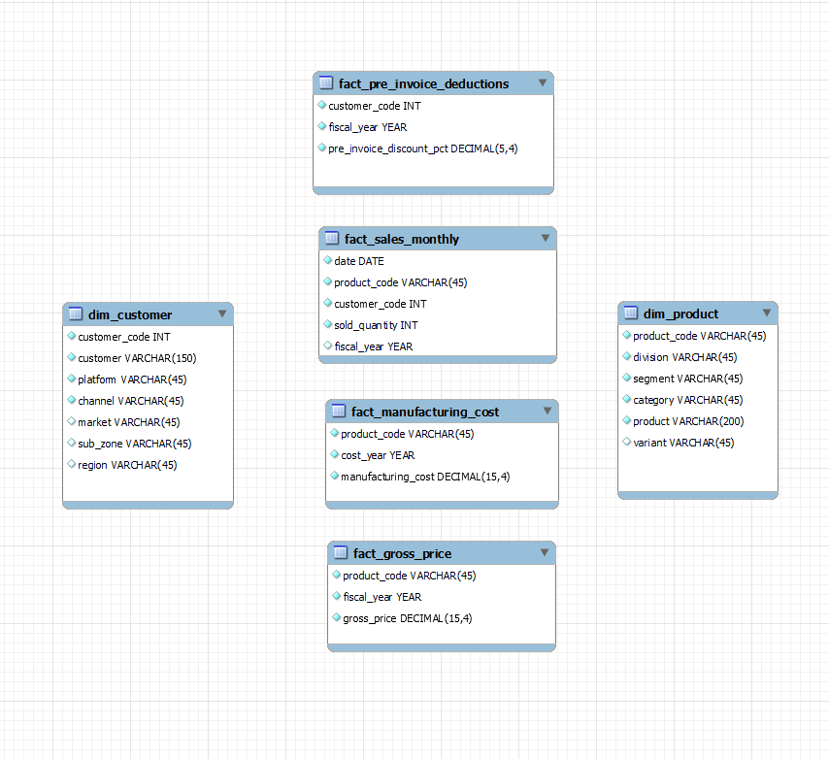
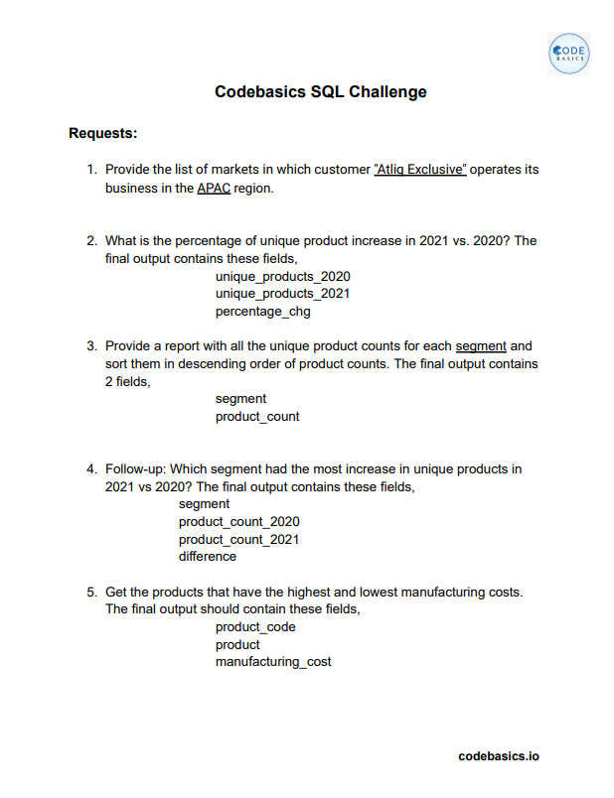
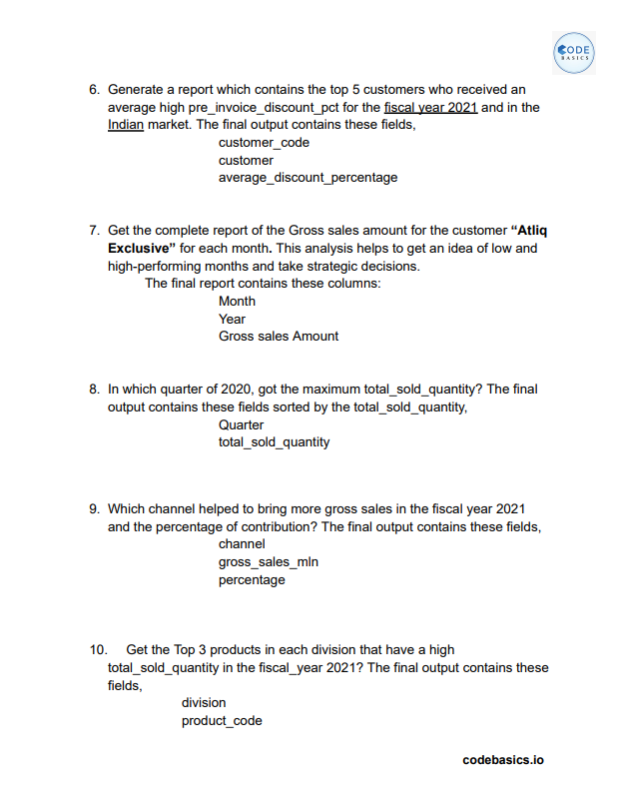
Dataset & Ad-Hoc Requests

Slide 8
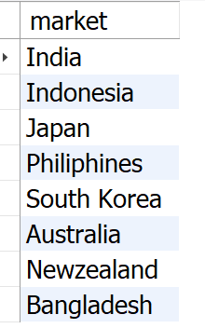
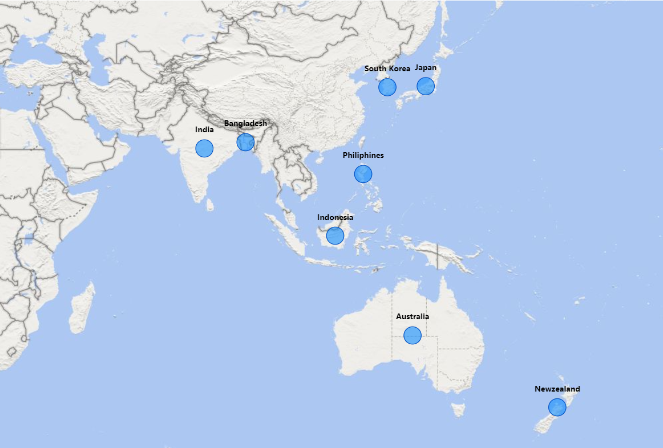
Ad-hoc requests , output and insights
Requests 1. Provide the list of markets in which customer "AtliQ Exclusive" operates its business in the APAC region.
Output
SELECT market FROM dim_customer
WHERE customer = 'AtliQ Exclusive' AND region = 'APAC'
ORDER BY market ;
Insights :
AtliQ Exclusive operates in eight countries within the APAC region, demonstrating a significant regional market presence.

Slide 9
What is the percentage of unique product increase in 2021 vs. 2020? The final output contains these fields, unique_products_2020, unique_products_2021, percentage_chg .
Requests 2.
SELECT X.A AS unique_product_2020, Y.B AS unique_products_2021, ROUND((B-A)*100/A, 2) AS percentage_chg
FROM
(
(SELECT COUNT(DISTINCT(product_code)) AS A FROM fact_sales_monthly
WHERE fiscal_year = 2020) X,
(SELECT COUNT(DISTINCT(product_code)) AS B FROM fact_sales_monthly
WHERE fiscal_year = 2021) Y
);
Output

Slide 10
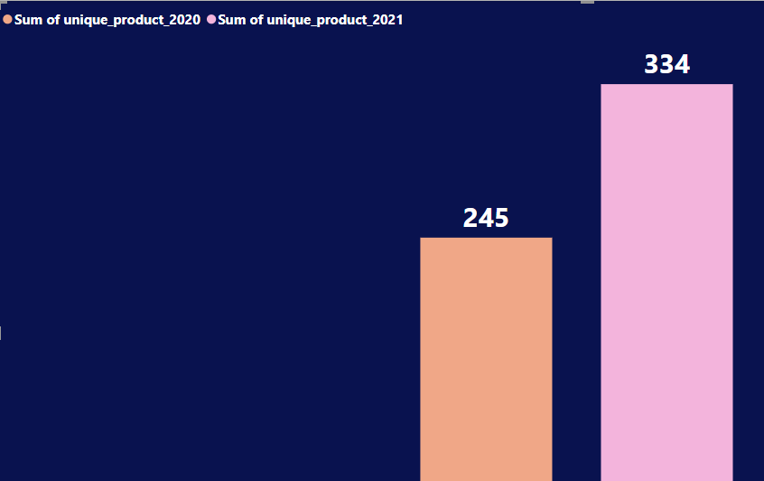
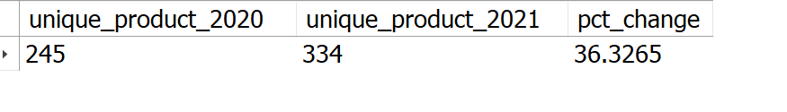
36.33%
Insights:
1. The number of unique products grew from 245 in 2020 to 334 in 2021, marking a 36.33% increase. 2. This significant increase highlights the company's commitment to innovation and meeting diverse customer needs.

Slide 11
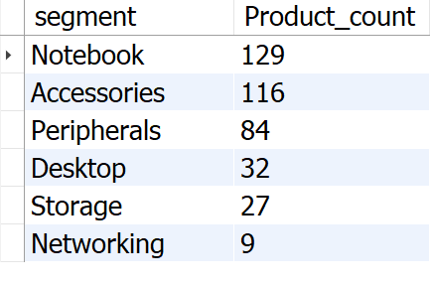
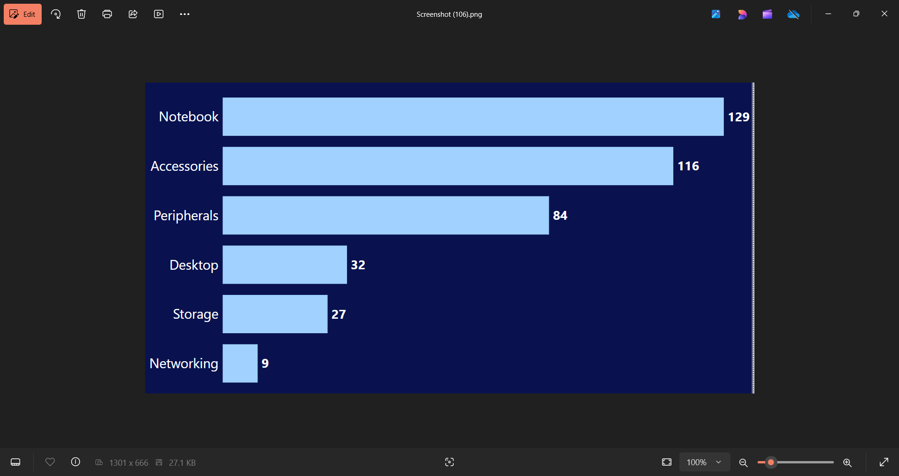
Requests 3.
Provide a report with all the unique product counts for each segment and sort them in descending order of product counts. The final output contains 2 fields, segment, product count.
output
SELECT segment,
COUNT(DISTINCT(product_code)) AS
product_count
FROM dim_product
GROUP BY segment
ORDER BY product_count DESC ;
Insights:
1. AtliQ shines in Notebooks, Accessories, and Peripherals segment, accounting for a whopping 82.87% of product variety. 2. Desktops, Storage, and Networking currently hold a minor share (17.13%) of AtliQ's product portfolio. 3. In Desktops, Storage, and Networking segment AtliQ should focus on products that align with current customer trends and industry demands.

Slide 12
Requests 4.
Follow-up: Which segment had the most increase in unique products in 2021 vs 2020? The final output contains these fields, segment, product_count_2020, product_count_2021, difference.
WITH CTE1 AS
(SELECT P.segment AS A , COUNT(DISTINCT(FS.product_code)) AS B
FROM dim_product P, fact_sales_monthly FS
WHERE P.product_code = FS.product_code
GROUP BY FS.fiscal_year, P.segment
HAVING FS.fiscal_year = "2020"),
CTE2 AS
(
SELECT P.segment AS C , COUNT(DISTINCT(FS.product_code)) AS D
FROM dim_product P, fact_sales_monthly FS
WHERE P.product_code = FS.product_code
GROUP BY FS.fiscal_year, P.segment
HAVING FS.fiscal_year = "2021"
)
SELECT CTE1.A AS segment, CTE1.B AS product_count_2020, CTE2.D AS product_count_2021, (CTE2.D-CTE1.B) AS difference
FROM CTE1, CTE2
WHERE CTE1.A = CTE2.C ;
output

Slide 13
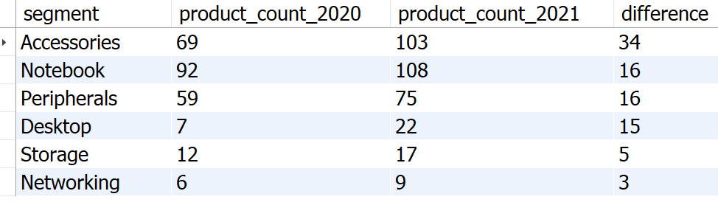
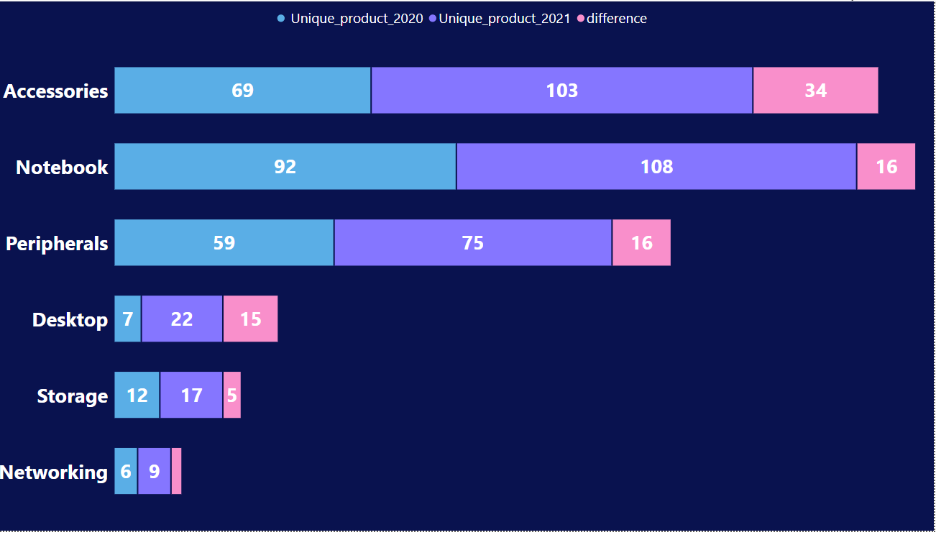
Insights:
1. Accessories have the most increased products from 2020 to 2021, with an increase of 34 new products.
2. Desktop products production increased drastically by approximately 214% from 2020 to 2021.
3. Storage and Networking segments are producing the least new products from 2020 to 2021.

Slide 14
Requests 5.
Get the products that have the highest and lowest manufacturing costs. The final output should contain these fields, product_code ,product, manufacturing_cost .
Output
SELECT F.product_code, P.product, F.manufacturing_cost
FROM fact_manufacturing_cost F JOIN dim_product P
ON F.product_code = P.product_code
WHERE manufacturing_cost
IN (
SELECT MAX(manufacturing_cost) FROM fact_manufacturing_cost
UNION
SELECT MIN(manufacturing_cost) FROM fact_manufacturing_cost
)
ORDER BY manufacturing_cost DESC ;

Slide 15
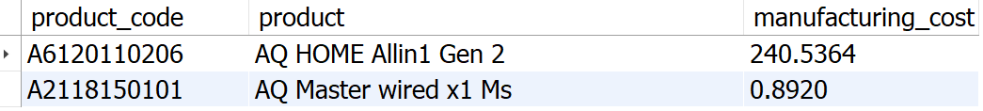

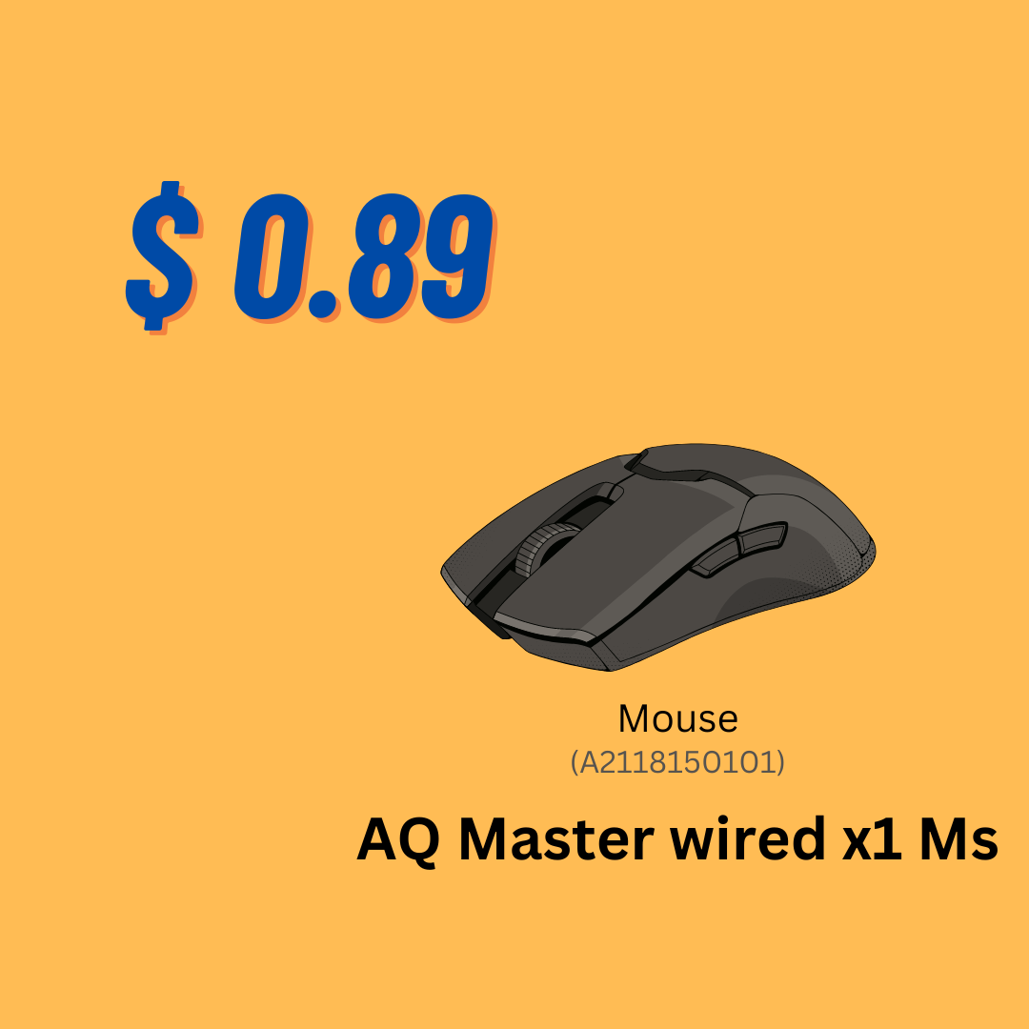
Lowest Manufacturing Cost Product
Highest Manufacturing Cost Product

Slide 16
Requests 6.
Generate a report which contains the top 5 customers who received an average high pre_invoice_discount_pct for the fiscal year 2021 and in the Indian market. The final output contains these fields, customer_code, customer, average_discount_percentage .
WITH TBL1 AS
(SELECT customer_code AS A, AVG(pre_invoice_discount_pct) AS B
FROM fact_pre_invoice_deductions
WHERE fiscal_year = '2021'
GROUP BY customer_code),
TBL2 AS
(SELECT customer_code AS C, customer AS D FROM dim_customer
WHERE market = 'India')
SELECT TBL2.C AS customer_code, TBL2.D AS customer, ROUND (TBL1.B, 4) AS average_discount_percentage
FROM TBL1 JOIN TBL2
ON TBL1.A = TBL2.C
ORDER BY average_discount_percentage DESC
LIMIT 5 ;
Output

Slide 17
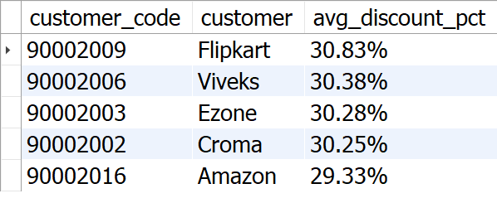
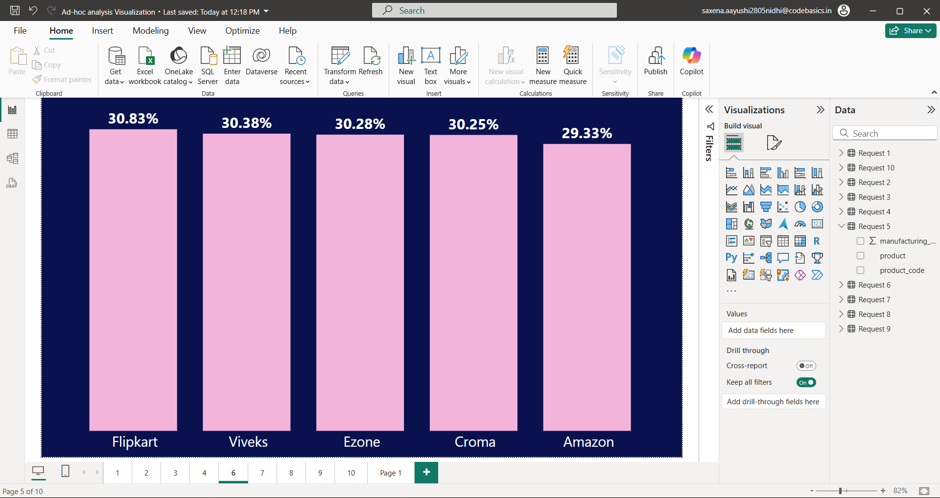
Insights:
1. Flipkart leads the list with the highest average discount percentage at 30.83%. 2. AtliQ has provided relatively uniform discount percentages to its top 5 customers, with a narrow range of discounts from 29.33% to 30.83%.

Slide 18
Requests 7.
Get the complete report of the Gross sales amount for the customer “AtliQ Exclusive” for each month. This analysis helps to get an idea of low and high-performing months and take strategic decisions. The final report contains these columns: Month, Year, Gross sales Amount.
output
SELECT CONCAT(MONTHNAME(FS.date), ' (', YEAR(FS.date), ')') AS 'Month', FS.fiscal_year,
ROUND(SUM(G.gross_price*FS.sold_quantity), 2) AS Gross_sales_Amount
FROM fact_sales_monthly FS JOIN dim_customer C ON FS.customer_code = C.customer_code
JOIN fact_gross_price G
ON FS.product_code = G.product_code
WHERE C.customer = 'AtliQ Exclusive'
GROUP BY Month, FS.fiscal_year
ORDER BY FS.fiscal_year ;

Slide 19
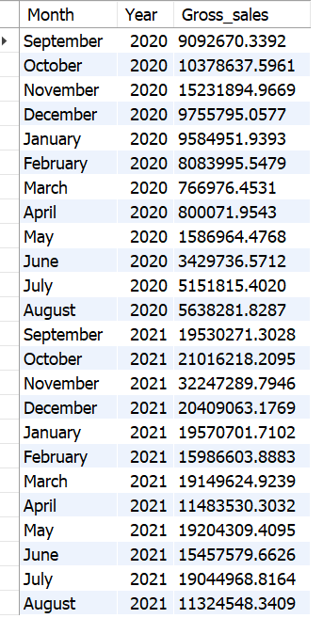
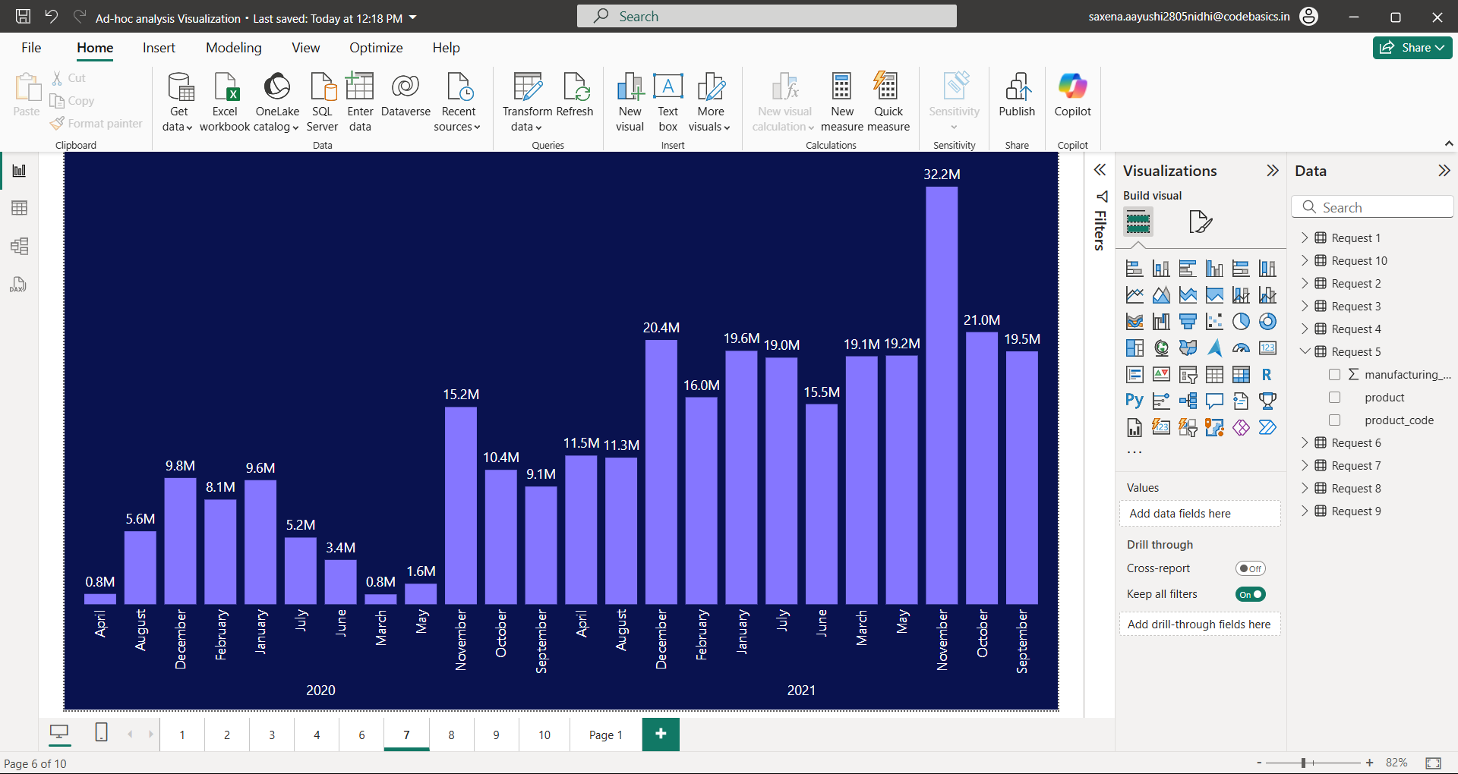
Insights:
1. March, April, May recorded the lowest sales in 2020, likely due to the COVID-19 pandemic. Sales began to recover after June 2020.
2. November generated the highest sales for 2020, with around 15.23 million.
3. Sales figures in 2021 show significant growth compared to 2020.
4. In 2021, the lowest sales were in August, accounting for 11.32 million, while the highest sales were in November, reaching 32.25 million.

Slide 20
Requests 8.
In which quarter of 2020, got the maximum total_sold_quantity? The final output contains these fields sorted by the total_sold_quantity, Quarter, total_sold_quantity.
Output
SELECT
CASE WHEN date BETWEEN '2019-09-01' AND '2019-11-01' then CONCAT('[',1,'] ‘,MONTHNAME(date))
WHEN date BETWEEN '2019-12-01' AND '2020-02-01' then CONCAT('[',2,'] ',MONTHNAME(date))
WHEN date BETWEEN '2020-03-01' AND '2020-05-01' then CONCAT('[',3,'] ',MONTHNAME(date))
WHEN date BETWEEN '2020-06-01' AND '2020-08-01' then CONCAT('[',4,'] ',MONTHNAME(date))
END AS Quarters,
SUM(sold_quantity) AS total_sold_quantity
FROM fact_sales_monthly
WHERE fiscal_year = 2020
GROUP BY Quarters;

Slide 21
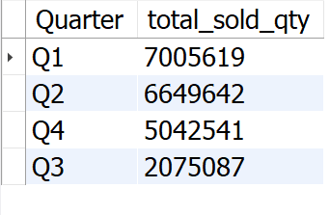
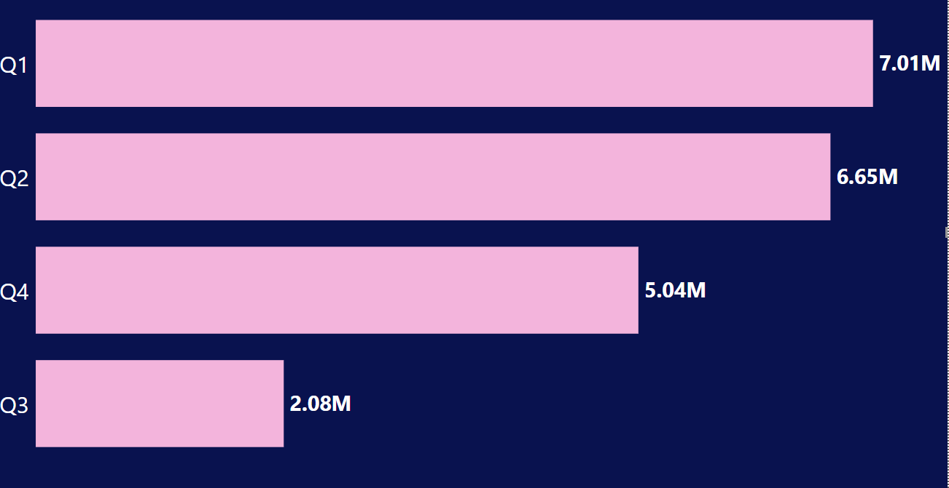
Insights:
1. Q1 (2020) saw the highest sales volume, reaching around 7 million units, indicating strong performance early in the year. 2. AtliQ experienced a significant decline in sales during Q3 (March, April, May), possibly due to the COVID-19 pandemic, reflecting challenging market conditions and shifting consumer behavior.

Slide 22
Requests 9.
Which channel helped to bring more gross sales in the fiscal year 2021 and the percentage of contribution? The final output contains these fields, channel, gross_sales_mln, percentage.
WITH Output AS
(
SELECT C.channel,
ROUND(SUM(G.gross_price*FS.sold_quantity/1000000), 2) AS Gross_sales_mln
FROM fact_sales_monthly FS JOIN dim_customer C ON FS.customer_code = C.customer_code
JOIN fact_gross_price G ON FS.product_code = G.product_code
WHERE FS.fiscal_year = 2021
GROUP BY channel
)
SELECT channel, CONCAT(Gross_sales_mln,' M') AS Gross_sales_mln , CONCAT(ROUND(Gross_sales_mln*100/total , 2), ' %') AS percentage
FROM
(
(SELECT SUM(Gross_sales_mln) AS total FROM Output) A,
(SELECT * FROM Output) B
)
ORDER BY percentage DESC;
output

Slide 23
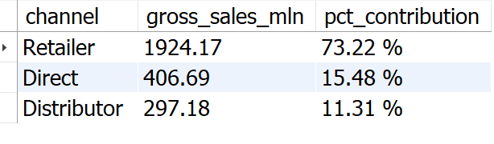
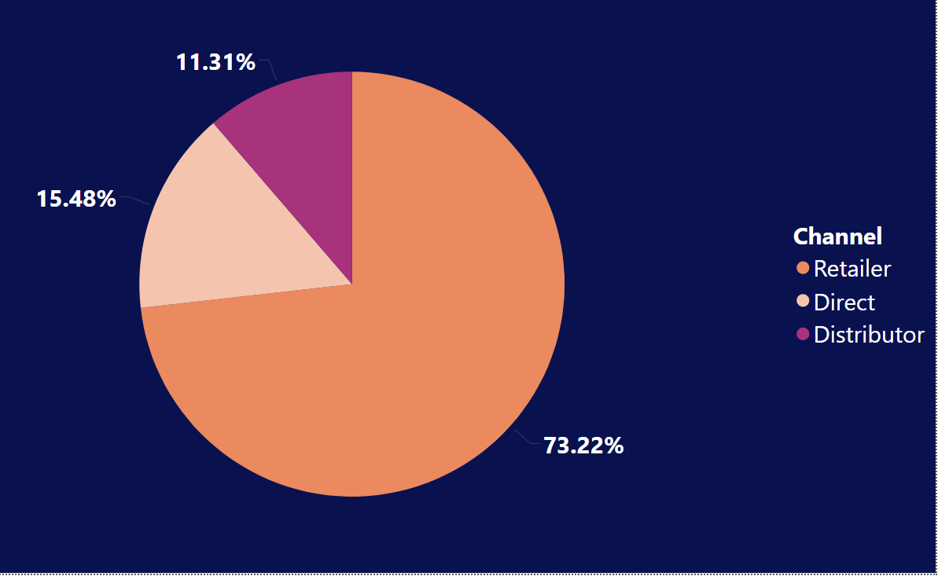
Insights:
1. The majority of AtliQ's sales come from retailers, accounting for a substantial 73.22% of the total gross sales. 2. Direct and distributor channel together contributes only 26.79% of the total sales.

Slide 24
Requests 10.
Get the Top 3 products in each division that have a high total_sold_quantity in the fiscal_year 2021? The final output contains these fields, division product_code product total_sold_quantity rank_order.
WITH Output1 AS
(
SELECT P.division, FS.product_code, P.product, SUM(FS.sold_quantity) AS Total_sold_quantity
FROM dim_product P JOIN fact_sales_monthly FS
ON P.product_code = FS.product_code
WHERE FS.fiscal_year = 2021
GROUP BY FS.product_code, division, P.product
),
Output2 AS
(
SELECT division, product_code, product, Total_sold_quantity,
RANK() OVER(PARTITION BY division ORDER BY Total_sold_quantity DESC) AS 'Rank_Order'
FROM Output1
)
SELECT Output1.division, Output1.product_code, Output1.product, Output2.Total_sold_quantity, Output2.Rank_Order
FROM Output1 JOIN Output2
ON Output1.product_code = Output2.product_code
WHERE Output2.Rank_Order IN (1,2,3);
output

Slide 25
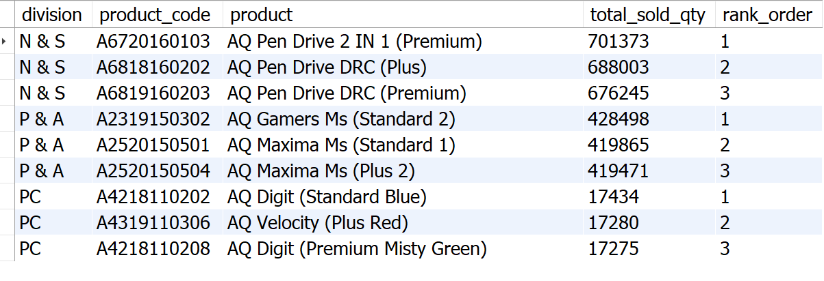
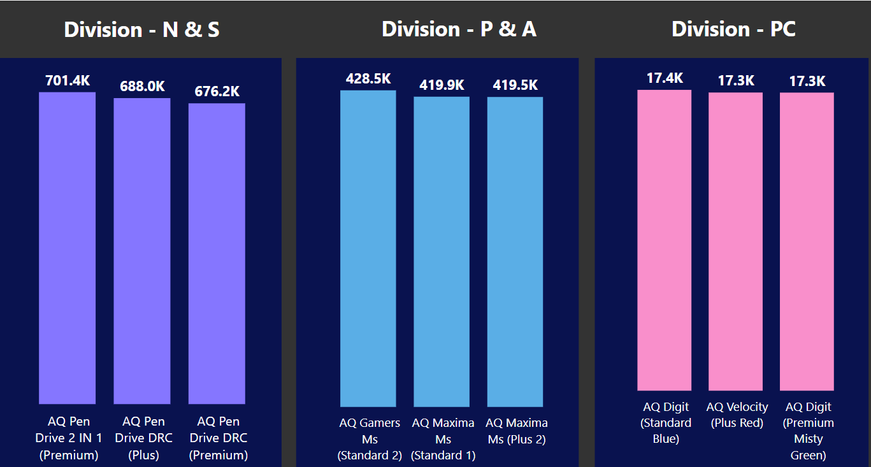
Insights:
1. In the N & S division, pen drives dominate the top three spots, showcasing their popularity and high sales performance. 2. The P & A division's top three products are exclusively mouse, reflecting a clear demand for these devices. 3. The PC division's bestsellers are all personal laptops.

Slide 26
Recommendations
1. Focus on desktops, Storage, and Networking segment. 2. Emphasizes multi-channel marketing. 3. Combine pricing strategies with attractive promotions. 4. Continuously improve based on customer feedback. 5. Invest in sales team training for improved performance.

Slide 27
Thankyou!

